Slide 1
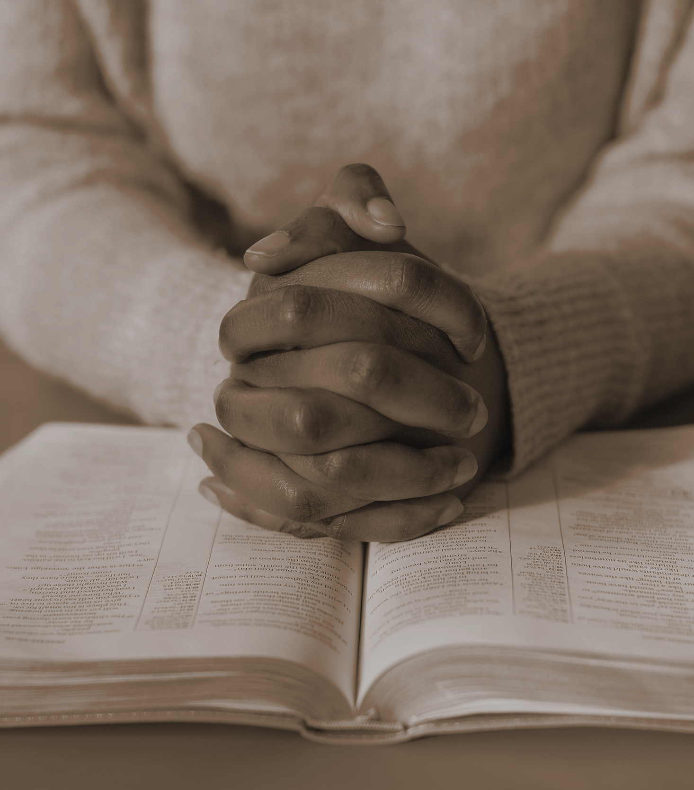
GRACE ASSEMBLY OF GOD CHURCH
BIBLE STUDY

Slide 2


MODULE 1: GOD OF THE BIBLE
1
Week 1 (7th March 2024): The Doctrine of God
2
Week 2 (14th March 2024): The Doctrine of Christ
3
Week 3 (21st March 2024): The Doctrine of The Holy Spirit
4
Week 4 (28th March 2024): The Doctrine of The Trinity

Slide 3

The Person of the Holy Spirit
The Holy Spirit is the Third Person of the Triune Godhead, who wants to be our Counsellor and lead us to Jesus and to God the Father.
The Holy Spirit is the source of power available to believers, to enable them to do God’s will and be what God wants them to be.
Through the Holy Spirit we can have the power and character of Jesus.
We need to learn to always acknowledge the Holy Spirit.
He directs us to Jesus and helps us understand the works of Christ. He also draws us closer to the Father and helps us to understand the love of God.

Slide 4
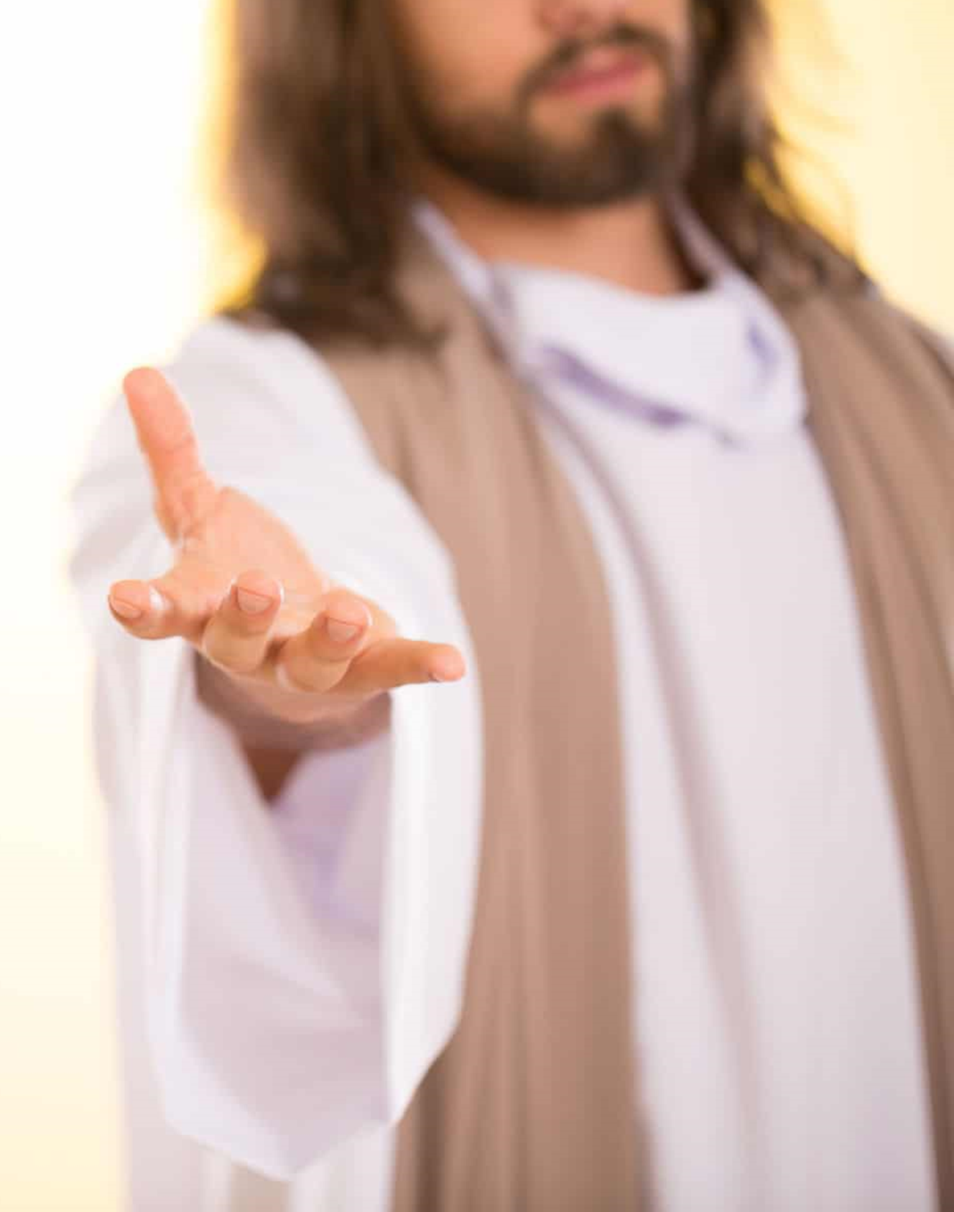
The Person of Christ
Jesus is God from the beginning
He is the Second Person of the Trinity
He is the Word of God
He is the High Priest and the only Mediator between us and the Father
He was the ultimate sacrifice
He gave His life, and no one could take it away from Him
Salvation in found only in Jesus
He is our Teacher
He is building His Church where He is the Head, and we are His body
Jesus is our Prophet, Priest and King

Slide 5
Uniqueness of our God
God is our Creator
God is our Provider
God is our Sustainer
Our God is a God of Love
Our God is a God of Mercy
Our God is a God of Justice
Our God is a God of Order
Our God is an Unchanging God
God Himself has No Beginning or End
Our God is Not Bound by Space or Time
Our God doesn’t have an idol or an image. He is a Jealous God
God is “all-powerful, all-knowing, and everywhere present.” He is Omnipotent, Omniscient, and the Omnipresent God.
God is Spirit.
God has a personality.
He is addressed as a Person and possesses all the attributes of personality.
He is an intelligent and moral Being whom we can trust, love and praise.
There is none to control Him.
He is not capable of the limitations and imperfections of our humanity.
There is no other like Him who is “glorious in holiness, fearful in praises, doing wonders”.
And He is before all things, and in Him all things hold together.

Slide 6

The Doctrine of The Trinity
(Referring the Book by Herbert Lockyer, titled “All the DOCTRINES of the Bible”)

Slide 7
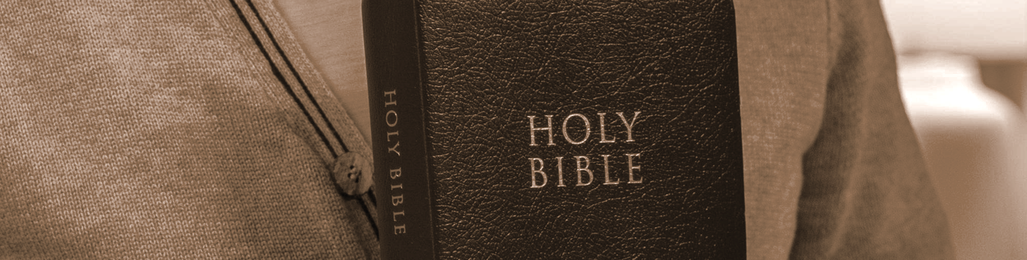
What do we know about Trinity?

Slide 8
The word ‘Trinity’ is derived from the Latin, ‘Trinitas’, from the adjective ‘Trinus’ meaning ‘Threefold’ or ‘three in one’.
While the term Trinity is not found in the Bible, the truth of it is covered across from Genesis to Revelation.
It is affirmed that the word Trinity itself was first formally used at the Synod held at Alexandria, in A.D. 317, and took its place in the language of Christian theology for the first time in a Biblical work of Theophilus, Bishop of Antioch, in Syria, from A.D. 168 to 183.
The Godhead is a Trinity in Unity seeing there are three inner distinctions but a single divine life. The three Persons are equal but one Essence.

Slide 9
Father God, Son of God, The Holy Spirit of God
One makes Three/ Three makes One
Trinity in Unity (They are always in unity)
Co-Eternal
Co-Equal

Slide 10
Jesus said in John 14:11, “I am in the Father and the Father is in Me.”
He said in verses 16 & 17 that I will ask the Father and He will give you the Holy Spirit.

Slide 11
John 15:26 (Amplified Bible)
“But when the Helper (Comforter, Advocate, Intercessor—Counselor, Strengthener, Standby) comes, whom I will send to you from the Father, that is the Spirit of Truth who comes from the Father, He will testify and bear witness about Me.
2 Corinthians 3:17 (New King James Version)
Now the Lord is the Spirit; and where the Spirit of the Lord is, there is liberty.
Galatians 4:6 (New Living Translation)
And because we are his children, God has sent the Spirit of his Son into our hearts, prompting us to call out, “Abba, Father.”

Slide 12
Similarities to the Trinity
Man: tripartite being, composed of spirit, soul and body
1 Thessalonians 5:23
New Living Translation
Now may the God of peace make you holy in every way and may your whole spirit and soul and body be kept blameless until our Lord Jesus Christ comes again.

Slide 13
Universe: presents itself to view as earth, sky and sea
Atmosphere: is made up of light, heat and air
Matter: is solids, liquids and gases
Water: found as liquid, ice and vapor
Sun: emits light, heat and chemical effects

Slide 14
This doctrine is a scriptural revelation of the Godhead consisting of –
The Father: the Great Upholder and Purpose of all things
The Son: the One and Only Redeemer of Mankind
The Holy Spirit: the Indispensable Sanctifier and Enlightener
Each having their own distinct spheres of operation yet found acting together in perfect unison.
THEY ARE EQUAL IN POSITION
THEY ARE EQUAL IN POWER

Slide 15
Elohim (Genesis 1:1) – plural noun, used about 500 times by Moses, and about 5000 times in the New Testament accompanied continually by a verb in the singular. This reveals the Oneness of Deity and the plurality of Persons in the Godhead.
Let us make man… after our likeness (Gen 1:26)
The man is become one of us (Gen 3:22)
Let us go down (Gen 11:7)

Slide 16
Hebrews 1:1-3 (Amplified Bible)
¹God, having spoken to the fathers long ago in [the voices and writings of] the prophets in many separate revelations [each of which set forth a portion of the truth], and in many ways, ² has in these last days spoken [with finality] to us in [the person of One who is by His character and nature] His Son [namely Jesus], whom He appointed heir and lawful owner of all things, through whom also He created the universe [that is, the universe as a space-time-matter continuum]. ³ The Son is the radiance and only expression of the glory of [our awesome] God [reflecting God’s Shekinah glory, the Light-being, the brilliant light of the divine], and the exact representation and perfect imprint of His [Father’s] essence and upholding and maintaining and propelling all things [the entire physical and spiritual universe] by His powerful word [carrying the universe along to its predetermined goal]. When He [Himself and no other] had [by offering Himself on the cross as a sacrifice for sin] accomplished purification from sins and established our freedom from guilt, He sat down [revealing His completed work] at the right hand of the Majesty on high [revealing His Divine authority],

Slide 17
All Three are called “God”
John 8:54 (New Living Translation)
Jesus answered, “If I want glory for myself, it doesn’t count. But it is my Father who will glorify me. You say, ‘He is our God,’
John 1:1 (Amplified Bible)
In the beginning [before all time] was the Word (Christ), and the Word was with God, and the Word was God Himself.
Acts 5:3-4 (New Living Translation)
³ Then Peter said, “Ananias, why have you let Satan fill your heart? You lied to the Holy Spirit, and you kept some of the money for yourself. ⁴ The property was yours to sell or not sell, as you wished. And after selling it, the money was also yours to give away. How could you do a thing like this? You weren’t lying to us but to God!”

Slide 18
Unity of God
John 17:3 (Amplified Bible)
Now this is eternal life: that they may know You, the only true [supreme and sovereign] God, and [in the same manner know] Jesus [as the] Christ whom You have sent.
1 Timothy 2:5 (Amplified Bible)
For there is [only] one God, and [only] one Mediator between God and mankind, the Man Christ Jesus,

Slide 19
At the birth of Jesus, we see this undeniable association of the Father, Son, and Holy Spirit.
Luke 1:35,37
Amplified Bible
³⁵ Then the angel replied to her, “The Holy Spirit will come upon you, and the power of the Most High will overshadow you [like a cloud]; for that reason the holy (pure, sinless) Child shall be called the Son of God. ³⁷ For with God nothing [is or ever] shall be impossible.”

Slide 20
At the baptism of Jesus, each of the Trinity is presented as a distinct Person.
Luke 3:21-22
Amplified Bible
²¹ Now when all the people were baptized, Jesus was also baptized, and while He was praying, the [visible] heaven was opened, ²² and the Holy Spirit descended on Him in bodily form like a dove, and a voice came from heaven, “You are My Son, My Beloved, in You I am well-pleased and delighted!”

Slide 21
Luke 10:22 (Amplified Bible)
All things have been transferred and turned over to Me by My Father and no one knows who the Son is except the Father, or who the Father is except the Son, and anyone to whom the Son wishes to reveal Him.”
Luke 12:12 (New King James Version)
For the Holy Spirit will teach you in that very hour what you ought to say.”

Slide 22
John 14:16-26 (Amplified Bible)
¹⁶ And I will ask the Father, and He will give you another Helper (Comforter, Advocate, Intercessor—Counselor, Strengthener, Standby), to be with you forever—
¹⁸ “I will not leave you as orphans [comfortless, bereaved, and helpless]; I will come [back] to you. ¹⁹ After a little while the world will no longer see Me, but you will see Me; because I live, you will live also. ²⁰ On that day [when that time comes] you will know for yourselves that I am in My Father, and you are in Me, and I am in you. ²¹ The person who has My commandments and keeps them is the one who [really] loves Me; and whoever [really] loves Me will be loved by My Father, and I will love him and reveal Myself to him [I will make Myself real to him].” ²³ Jesus answered, “If anyone [really] loves Me, he will keep My word (teaching); and My Father will love him, and We will come to him and make Our dwelling place with him. ²⁴ One who does not [really] love Me does not keep My words. And the word (teaching) which you hear is not Mine, but is the Father’s who sent Me.
²⁶ But the Helper (Comforter, Advocate, Intercessor—Counselor, Strengthener, Standby), the Holy Spirit, whom the Father will send in My name [in My place, to represent Me and act on My behalf], He will teach you all things. And He will help you remember everything that I have told you.

Slide 23
The Great Commission
Matthew 28:19 (New King James Version)
Go therefore and make disciples of all the nations, baptizing them in the name of the Father and of the Son and of the Holy Spirit,

Slide 24
The gifts and administrations of the church are ascribed to God, Christ and the Holy Spirit.
1 Corinthians 12:4-6 (Amplified Bible)
⁴ Now there are [distinctive] varieties of spiritual gifts [special abilities given by the grace and extraordinary power of the Holy Spirit operating in believers], but it is the same Spirit [who grants them and empowers believers]. ⁵ And there are [distinctive] varieties of ministries and service, but it is the same Lord [who is served]. ⁶ And there are [distinctive] ways of working [to accomplish things], but it is the same God who produces all things in all believers [inspiring, energizing, and empowering them

Slide 25
1 Thessalonians 1:2-5 (Amplified Bible)
² We give thanks to God always for all of you, continually mentioning you in our prayers; ³ recalling unceasingly before our God and Father your work energized by faith, and your service motivated by love and unwavering hope in [the return of] our Lord Jesus Christ. ⁴ Brothers and sisters beloved by God, we know that He has chosen you; ⁵ for our good news [regarding salvation] came to you not only in word, but also in [its inherent] power and in the Holy Spirit and with great conviction [on our part]. You know what kind of men we proved to be among you for your benefit.

Slide 26
The Three Persons of the Trinity repeatedly come forward together in the expression of Christian hope or the aspiration of Christian devotion.
1 Peter 1:2 (New Living Translation)
God the Father knew you and chose you long ago, and his Spirit has made you holy. As a result, you have obeyed him and have been cleansed by the blood of Jesus Christ.
May God give you more and more grace and peace.
Jude 20-21 (New Living Translation)
²⁰ But you, dear friends, must build each other up in your most holy faith, pray in the power of the Holy Spirit, ²¹ and await the mercy of our Lord Jesus Christ, who will bring you eternal life. In this way, you will keep yourselves safe in God’s love.

Slide 27
In all of Paul’s epistles, all three Persons are brought together as Co-Sources of all saving blessings which are the heritage of all believers in Christ.
May God our Father and the Lord Jesus Christ give you grace and peace. (Rom 1:7)
There is only one God… (Rom 3:30)
Titus 3:4-6 (Amplified Bible)
⁴ But when the goodness and kindness of God our Savior and His love for mankind appeared [in human form as the Man, Jesus Christ], ⁵ He saved us, not because of any works of righteousness that we have done, but because of His own compassion and mercy, by the cleansing of the new birth (spiritual transformation, regeneration) and renewing by the Holy Spirit, ⁶ whom He poured out richly upon us through Jesus Christ our Savior,

Slide 28
The great apostolic benediction: the three highest redemptive blessings are brought together and attached (distributed) to the three Persons of the Triune God.
2 Corinthians 13:14 (New Living Translation)
May the grace of the Lord Jesus Christ, the love of God, and the fellowship of the Holy Spirit be with you al

Slide 29
Paul saturates his Ephesian letter with his concept of the Trinity. Each chapter carries its own evidence.
Ephesians 5:18-20 (Amplified Bible)
¹⁸ Do not get drunk with wine, for that is wickedness (corruption, stupidity), but be filled with the [Holy] Spirit and constantly guided by Him. ¹⁹ Speak to one another in psalms and hymns and spiritual songs, [offering praise by] singing and making melody with your heart to the Lord; ²⁰ always giving thanks to God the Father for all things, in the name of our Lord Jesus Christ;

Slide 30
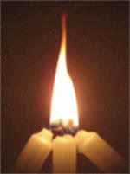
Summarizing the Trinity

Slide 31
The Father is first in mode of operation. He is the Fountain Head of grace. He is the Father of the Lord Jesus Christ (Eph 3:14); and the Father of all men, as the Source of their being; and particularly the loving Father of all those redeemed by the Blood of His Son (1 Cor 6:17,18; 8:6; Eph 4:6; Luke 12:30,32).

Slide 32
The Son is second in the process of manifestation, and the Medium of all things, even Judgement (John 5:22). He came as grace personified. He appeared and died as the Redeemer of mankind. It was through Him that God manifested Himself outwardly to all men (Acts 5:31; 13:38-39).

Slide 33
The Holy Spirit is third, seeing His is the last revealed personality, and the One who came as the Agent transferring the blessings of the Father and the Son upon the redeemed (Eph 2:18). He shares the attributes ascribed to God and Christ (Ps 139:7; 1 Cor 2:10-11; Isa 40:13-14) and is especially the Helper and Sanctifier of the saved (1 Cor 6:11; Gal 5:16). As the Channel, the Holy Spirit communicates, applies and seals. The order of divine performance appears to be – From the Father; Through the Son; By the Holy Spirit.

Slide 34
They are One in holiness, love, wisdom, power and eternal nature
There is One God existing in Three Persons
All Three deserve equal reverence
All Three deserve equal love
We need to obey all Three
They are EQUAL in POSITION AND POWER

Slide 35
Dr. R. W. Dale expresses:
If you love and obey and trust and worship the Lord Jesus Christ as a divine person; If you shrink from sin lest you should “grieve” the Holy Spirit, if His care for you and His patience with you fill your heart with courage and gratitude; and if you believe, at the same time, that the Son and the Spirit are one with the Eternal Father, your life is rooted in the facts which the doctrine of the Trinity is intended to express, although you may be unable to accept the Trinitarian creed.

Slide 36


HAVE A BLESSED WEEK WITH THE TRINITY!!

